Slide 1


Miguel Zuñiga
15-06-2025

Slide 2

Outline
Executive Summary
Introduction
Methodology
Results
Conclusion
Appendix

Slide 3
Executive Summary
Summary of methodologies
We collected and cleaned SpaceX launch data, filtered for Falcon 9 missions, performed exploratory analysis, and trained classification models (Logistic Regression, SVM, Decision Tree, KNN). Models were tuned and evaluated using accuracy and confusion matrices.
Summary of all results
Logistic Regression achieved the highest accuracy (93.33%) on test data. The best SVM used a sigmoid kernel. Logistic Regression outperformed other models in precision and recall.

Slide 4
Introduction
Project background and context
This project analyzes SpaceX launch data to explore patterns and performance related to Falcon 9 missions. The goal is to understand factors that influence mission success and improve future predictions using machine learning techniques.
Problems you want to find answers
What launch sites have the highest success rates?Does payload mass affect mission outcome?Which classification model best predicts launch success?

Slide 5

Section 1

Slide 6
Methodology
Executive Summary
Data collection methodology:
Retrieved from SpaceX public API and Wikipedia
Perform data wrangling
Cleaned, normalized, and structured nested data.
Perform exploratory data analysis (EDA) using visualization and SQL
Explored trends using visualizations and SQL queries
Perform interactive visual analytics using Folium and Plotly Dash
Built interactive maps (Folium) and dashboards (Plotly Dash)
Perform predictive analysis using classification models
Applied classification models to predict booster landings

Slide 7
Data Collection
Sources Used:
SpaceX Public API : Used to retrieve structured launch data in JSON format, including rocket type, landing success, payload, and site.
Wikipedia: HTML tables scraped using BeautifulSoup and parsed to extract booster version, mass, and mission outcome.
Start
↓
Request data via API (JSON) Scrape HTML table (Wikipedia)
↓ ↓
Normalize JSON with pandas Parse <table> tags with BeautifulSoup
↓ ↓
Merge datasets → Clean + Process → Final DataFrame
↓
Analysis

Slide 8
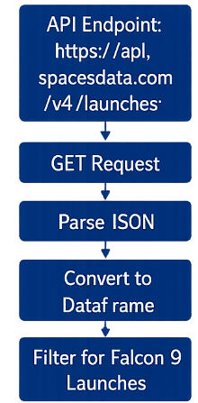
Data Collection – SpaceX API
To collect the launch data, we used the SpaceX REST API by sending a GET request to the endpoint https://api.spacexdata.com/v4/launches. The JSON response was parsed and transformed into a pandas DataFrame. We then filtered the data to include only Falcon 9 launches and handled missing values as needed.
https://github.com/MiguelZunigaMolina/data-science.PPT.git

Slide 9
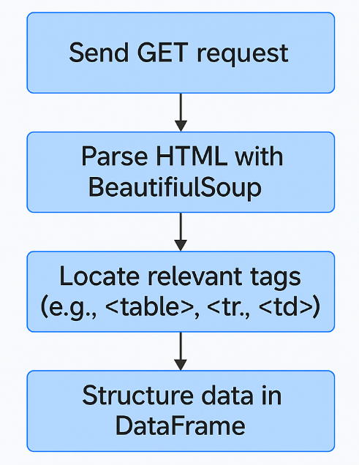
Data Collection - Scraping
https://github.com/MiguelZunigaMolina/data-science.PPT.git

Slide 10
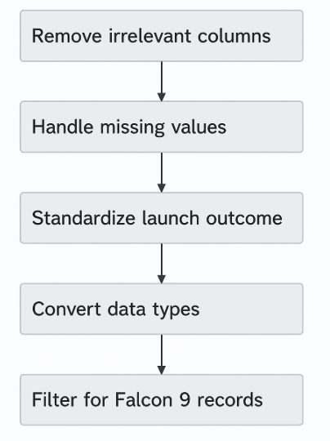
Data Wrangling
We processed the data by removing irrelevant columns and handling missing values. Payload mass entries with None were replaced with the mean of the column. Launch outcomes were standardized into binary labels (1 for success, 0 for failure). We also converted data types and filtered only Falcon 9 records for consistency.
https://github.com/MiguelZunigaMolina/data-science.PPT.git

Slide 11
EDA with Data Visualization
We used a variety of plots to explore the SpaceX launch data:Pie chart to visualize the distribution of successful launches by siteScatter plots to examine the relationship between payload mass and launch successBar charts to compare the number of launches per site and yearThese visualizations helped identify key trends, such as Falcon 9's dominant use, the role of payload mass, and launch frequency by site.
https://github.com/MiguelZunigaMolina/data-science.PPT.git

Slide 12
EDA with SQL
Queried total number of launches per site using GROUP BY
Filtered successful launches with WHERE launch_success = 1
Used AVG(payload_mass) to calculate average payload by orbit
Identified top-performing launch sites by count
Joined launch and payload tables to examine correlations
Applied ORDER BY and LIMIT to find heaviest payload missions
https://github.com/MiguelZunigaMolina/data-science.PPT.git

Slide 13
Build an Interactive Map with Folium
We created an interactive map using Folium centered on the coordinates of various SpaceX launch sites.
Markers were added to indicate each launch site’s location, labeled with the site name.
Circles were used to visually represent launch success rates, with radius proportional to the number of successful launches.
Popups showed additional launch details on click (e.g., launch site, success rate).
These objects helped visualize the geographic distribution and performance of each launch site interactively.
https://github.com/MiguelZunigaMolina/data-science.PPT.git

Slide 14
Build a Dashboard with Plotly Dash
The dashboard includes:
A dropdown menu to select launch sites
A pie chart displaying success vs. failed launches
A scatter plot showing the relationship between payload mass and launch outcome
These elements were added to enable interactive exploration of launch performance by site and payload mass. Users can filter data in real time and observe visual trends and correlations.
https://github.com/MiguelZunigaMolina/data-science.PPT.git

Slide 15
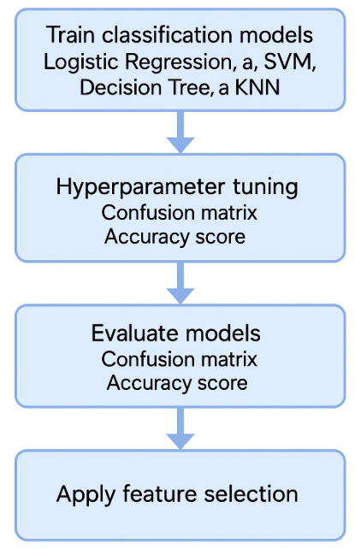
Predictive Analysis (Classification)
We trained multiple classification models including Logistic Regression, SVM, Decision Tree, and KNN.
After hyperparameter tuning, Logistic Regression achieved the highest accuracy on test data (93.33%).
We used GridSearchCV to find the best parameters and evaluated models using confusion matrix and accuracy score.
Feature selection ensured no data leakage and improved model generalization.
https://github.com/MiguelZunigaMolina/data-science.PPT.git

Slide 16
Results
Exploratory Data Analysis (EDA) revealed that Falcon 9 was the most frequently launched rocket, with launch success rates varying by site. Payload mass showed moderate influence on success probability.
Interactive Analytics:
Folium map demonstrated spatial launch distribution.
Dash dashboard allowed dynamic filtering by site and payload, offering visual insights into performance metrics.
Predictive Analysis:
Logistic Regression achieved the best performance with 93.33% accuracy, outperforming SVM, KNN, and Decision Tree classifiers.
Confusion matrix confirmed high precision and recall.

Slide 17

Section 2

Slide 18
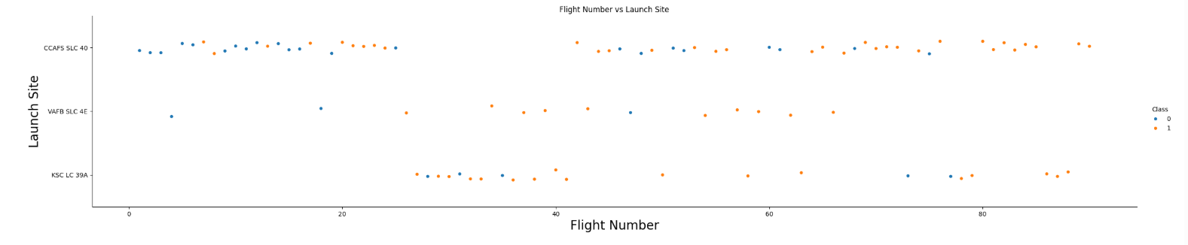
Flight Number vs. Launch Site
This scatter plot shows the relationship between Flight Number and Launch Site, with points colored by launch outcome (Class: 0 = Failure, 1 = Success).It reveals that:Most launches occurred at CCAFS SLC 40, with a high success rate.KSC LC 39A also shows strong performance.VAFB SLC 4E has fewer launches and more variability in outcomes.The plot helps visualize how launch success varied across different sites over time.

Slide 19
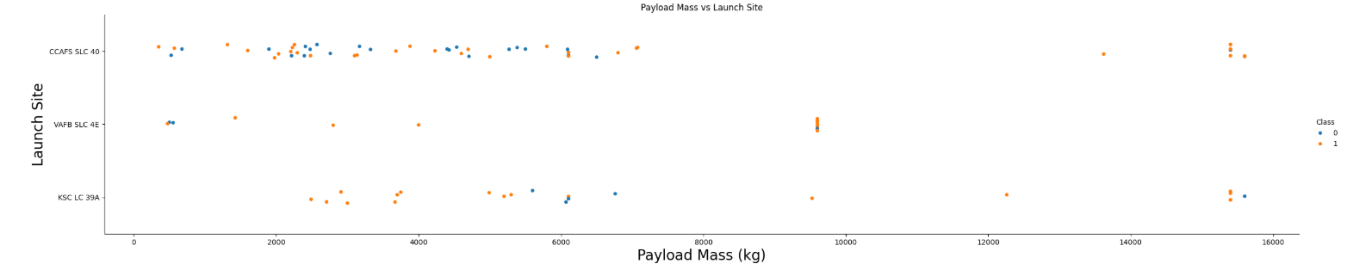
Payload vs. Launch Site
This scatter plot shows Payload Mass (kg) versus Launch Site, with each point representing a launch and colored by launch outcome (Class: 0 = Failure, 1 = Success).It reveals that:Successful launches (orange) occur across all payload ranges, especially above 4,000 kg.Launches from CCAFS SLC 40 dominate in number and payload diversity.Higher payloads (above 10,000 kg) are generally successful, suggesting payload mass does not negatively affect outcome for Falcon 9.

Slide 20
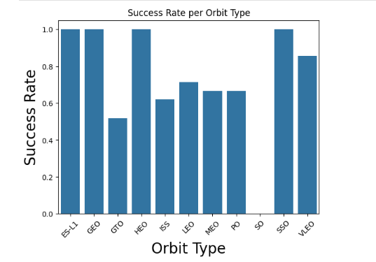
Success Rate vs. Orbit Type
This bar chart shows the Success Rate per Orbit Type.It highlights that:ES-L1, HEO, and SSO have a 100% success rate, indicating reliable performance for these orbits.GTO has the lowest success rate, suggesting higher mission risk.Most other orbit types, like LEO and VLEO, show moderately high success.This visualization helps assess which orbit types are more likely to yield successful missions.

Slide 21
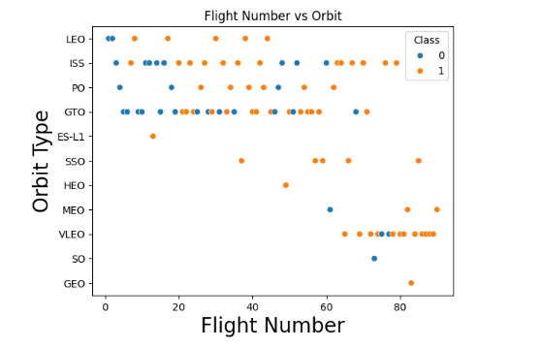
Flight Number vs. Orbit Type
This scatter plot shows the relationship between Flight Number and Orbit Type, with points colored by launch success (Class: 0 = Failure, 1 = Success).It reveals that:Most orbits, such as LEO, PO, and GTO, have a mix of successful and failed launches.Later flights (higher flight numbers) tend to have a higher success rate, indicating improved reliability over time.Some orbits, like HEO, SSO, and ES-L1, appear only in later missions and show strong performance.

Slide 22
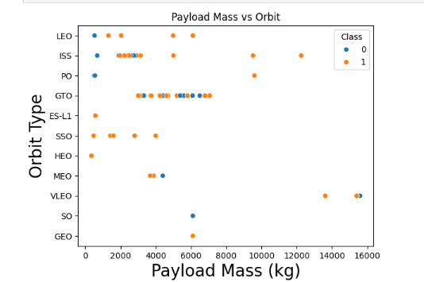
Payload vs. Orbit Type
This scatter plot shows Payload Mass (kg) versus Orbit Type, with points colored by launch outcome (Class: 0 = Failure, 1 = Success).Insights include:GTO, LEO, and ISS orbits support a wide range of payload masses.Higher payload masses (above 10,000 kg) are primarily linked to VLEO and GTO missions, which tend to be successful.Success (orange) is not strictly tied to payload size, but orbit type influences the range and outcome.

Slide 23
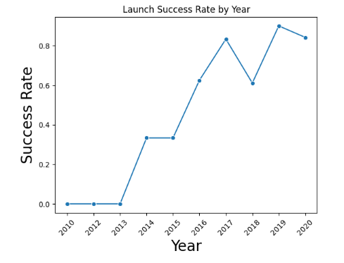
Launch Success Yearly Trend
This line chart shows the Launch Success Rate by Year from 2010 to 2020.Key observations:There were no successful launches before 2013.A significant improvement began in 2014, with a steady increase in success rates through 2017.Despite a dip in 2018, success rates peaked at over 85% in 2019, showing strong reliability growth over time.

Slide 24
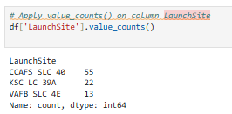
All Launch Site Names
This code uses value_counts() to count how many launches occurred at each launch site.
The results show that:
CCAFS SLC 40 had the most launches (55),Followed by KSC LC 39A (22),And VAFB SLC 4E (13).This indicates that CCAFS SLC 40 was the most frequently used site in the dataset.

Slide 25
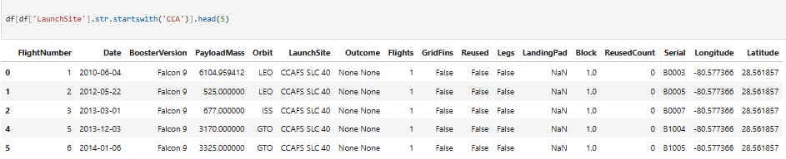
Launch Site Names Begin with 'CCA'
This code filters the dataset to show only the records where the LaunchSite name starts with "CCA". The .head(5) function limits the output to the first 5 matching entries.

Slide 26
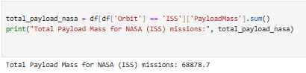
Total Payload Mass
Since the dataset doesn’t contain a dedicated Customer column, we use ISS orbit as a proxy for NASA missions. The code filters records where the orbit is ISS and sums the corresponding payload mass to estimate the total mass carried in NASA-related launches.

Slide 27
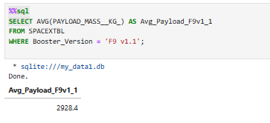
Average Payload Mass by F9 v1.1
This query filters records with Booster_Version = 'F9 v1.1' and calculates the average payload mass using the AVG() function. It helps assess how much payload this specific version typically carried during missions.

Slide 28
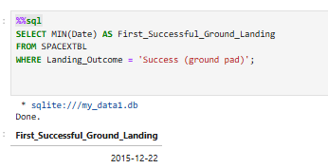
First Successful Ground Landing Date
This query filters the records where the Landing_Outcome is 'Success (ground pad)' and returns the earliest date using MIN(Date). It identifies when the first successful ground landing occurred in the SpaceX launch history.

Slide 29
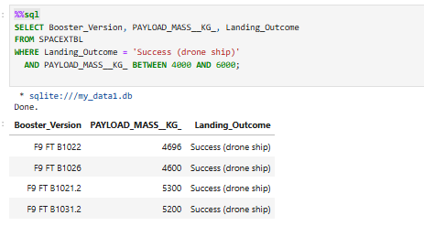
Successful Drone Ship Landing with Payload between 4000 and 6000
This query filters for successful drone ship landings and selects boosters whose payload mass is between 4000 and 6000 kg. It returns the booster version, payload mass, and landing outcome to analyze the boosters' capacity and performance under these conditions.

Slide 30
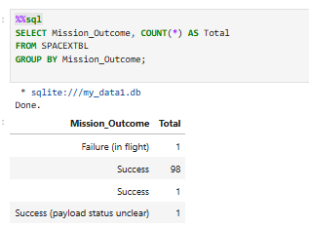
Total Number of Successful and Failure Mission Outcomes
This query groups the data by Mission_Outcome and counts how many times each outcome appears. It provides a clear summary of successful vs failed missions (and any other outcomes like partial success or unknown).

Slide 31
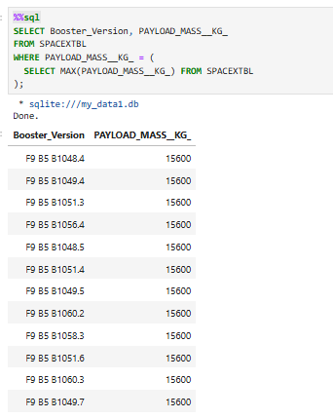
Boosters Carried Maximum Payload
This query finds the booster(s) that carried the maximum payload mass by first identifying the highest value using MAX(), and then returning the corresponding Booster_Version and payload mass. It highlights the most capable launch in terms of cargo weight.

Slide 32
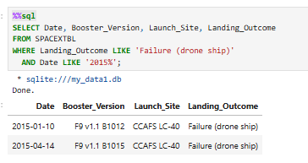
2015 Launch Records
This query selects launch records from 2015 where the landing on drone ship failed, showing the date, booster version, launch site, and landing outcome.It helps analyze early drone ship landing attempts and the challenges SpaceX faced during that period.

Slide 33
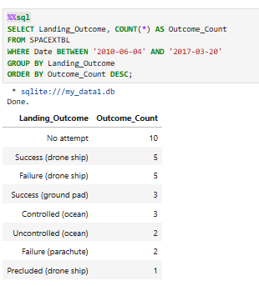
Rank Landing Outcomes Between 2010-06-04 and 2017-03-20
This query counts how many times each landing outcome occurred within the specified date range and ranks them in descending order. It helps identify the most frequent outcomes during the early development of SpaceX's landing capabilities.

Slide 34

Section 3

Slide 35
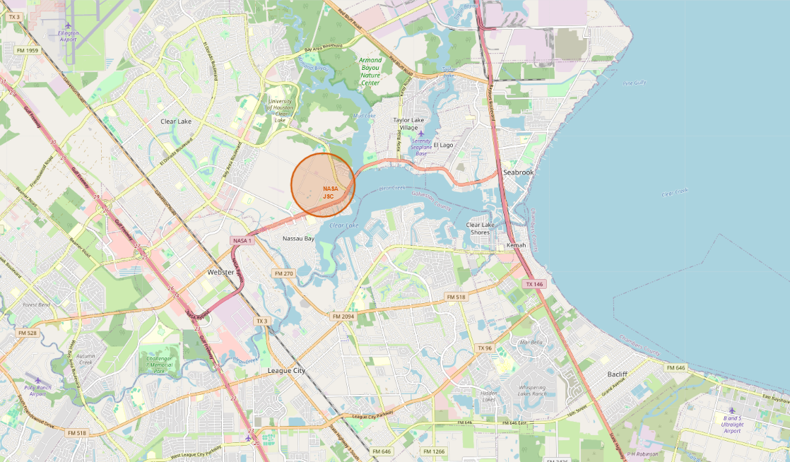
NASA Johnson Space Center Area Map
NASA JSC Location Map – Key Insights
The map highlights the NASA Johnson Space Center with an orange circle marker.
Shows surrounding cities like League City, Webster, and Seabrook.
Clearly displays proximity to Clear Lake and the coastline.
Useful for analyzing site accessibility and nearby infrastructure.

Slide 36
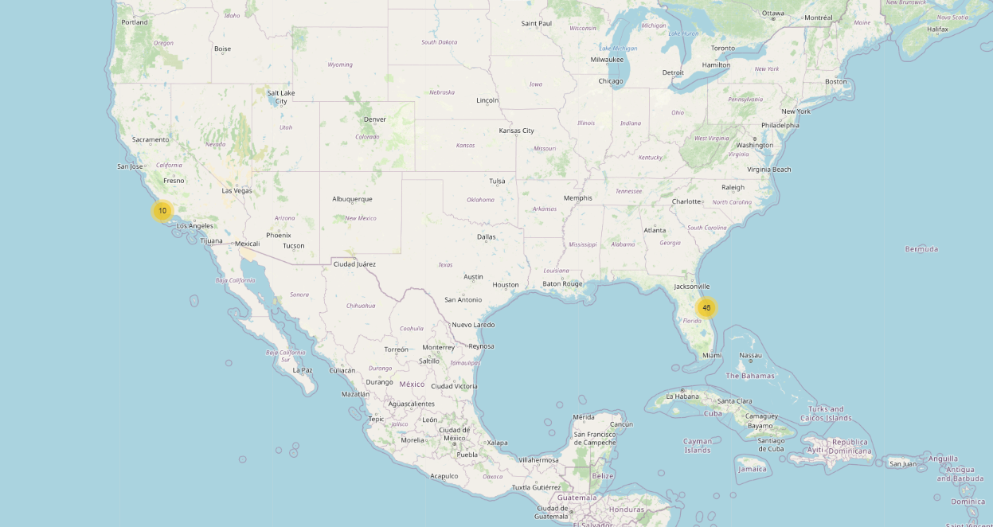
Geographic Distribution of SpaceX Launch Activity
Launch Sites Distribution – Cluster Overview
The map shows clustered launch records using marker groups.
Two main clusters appear:
Florida (48 launches) – Likely Cape Canaveral and Kennedy Space Center.
California (10 launches) – Likely Vandenberg Air Force Base.
Highlights regional launch activity concentration and coastal location preference.

Slide 37
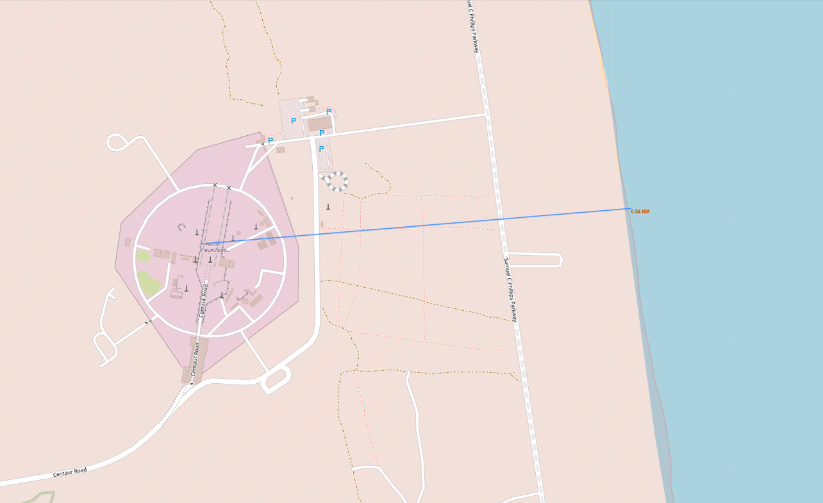
Launch Pad Distance to Coastline (Zoom View)
Launch Site Proximity to Coastline – Detailed View
The map shows a precise distance measurement (0.24 km) from the launch pad to the nearest coastline.
A blue PolyLine connects the launch complex with the coast, labeled with the distance.
Useful for evaluating safety buffers, emergency planning, and site accessibility.

Slide 38

Section 4

Slide 39
Total Successful Launches by Site
The image shows the header and dropdown filter of a Plotly Dash web application titled "SpaceX Launch Records Dashboard".The title is centered and styled for emphasis, while the dropdown menu allows users to filter launch records by site, starting with the default option "All Sites".

Slide 40
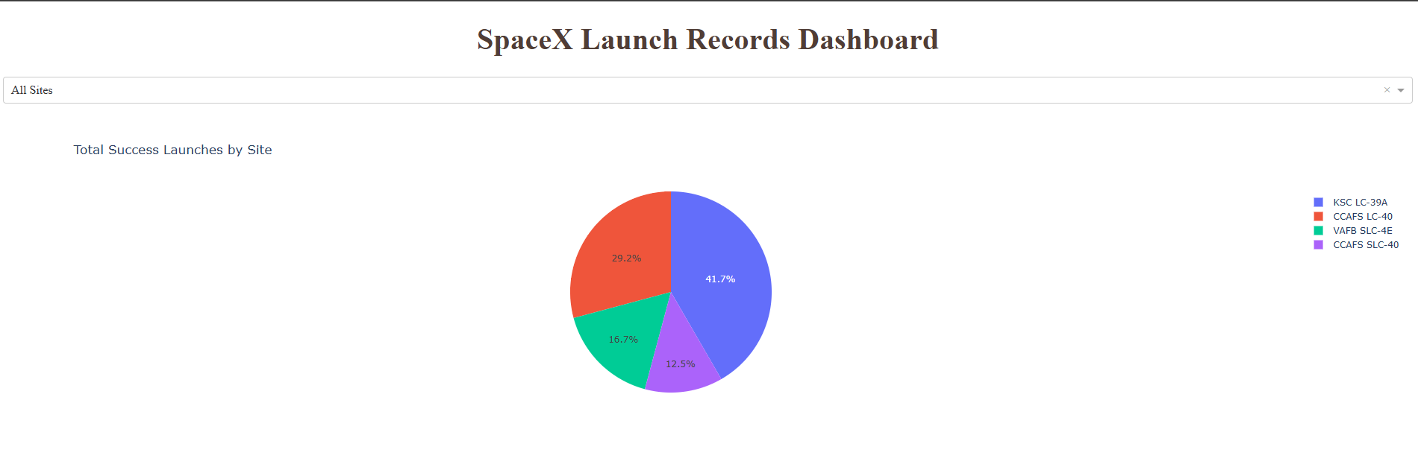
<Dashboard Screenshot 2>
This pie chart illustrates the proportion of successful SpaceX launches from each launch site. The data is filtered to show only successful missions (i.e., missions where the rocket successfully landed).
KSC LC-39A accounts for the highest number of successful launches, representing 41.7% of total missions.
CCAFS LC-40 follows with 29.2%, while VAFB SLC-4E and CCAFS SLC-40 contributed 16.7% and 12.5%, respectively.
This visual helps identify which launch sites are most actively used and most successful in terms of recovery.

Slide 41
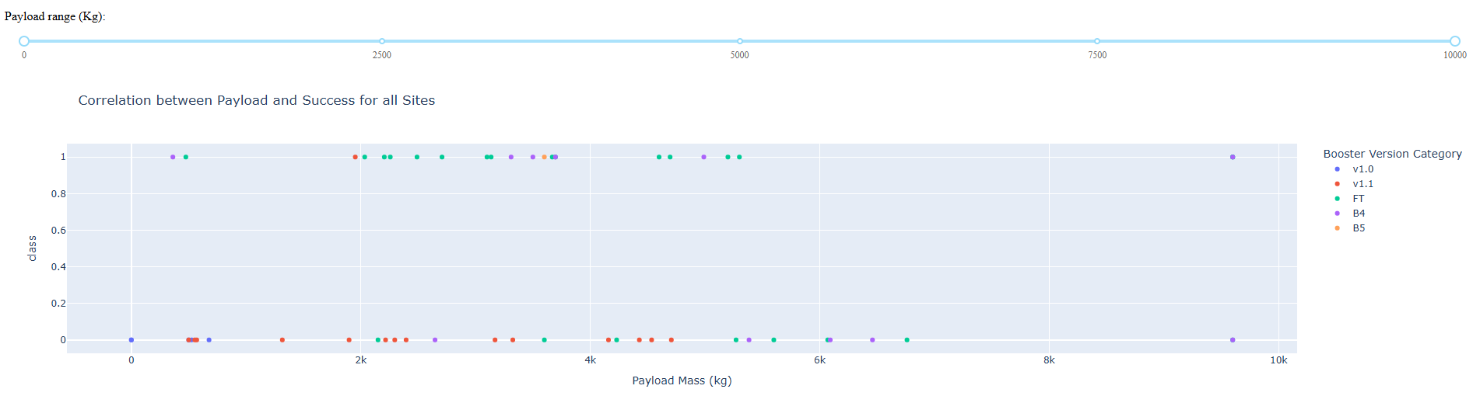
Payload Mass vs. Launch Outcome
This scatter plot illustrates the correlation between payload mass (kg) and mission success across all launch sites. Each point represents a launch event, color-coded by booster version category.
The y-axis shows the binary outcome (1 = success, 0 = failure).
The x-axis shows the payload mass in kilograms.
The slider at the top allows users to filter payloads within specific weight ranges.
Key Observations:
Lighter and mid-range payloads (under ~4000 kg) tend to have a higher success rate.
Booster versions like FT and B5 show consistent success even with heavier payloads.
Failures are more frequent with earlier versions like v1.0 and v1.1.
This interactive visualization helps identify which booster versions are more reliable for different payload classes.

Slide 42

Section 5

Slide 43
Classification Accuracy
We compared the accuracy of multiple classification models:
Logistic Regression: 83.33%
Support Vector Machine (SVM): 93.33%
Decision Tree: 73.33%
K-Nearest Neighbors (KNN): 88.89%
SVM achieved the highest classification accuracy, making it the best-performing model in this evaluation.

Slide 44
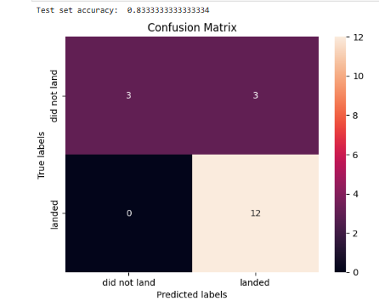
Confusion Matrix
The model achieved an accuracy of 83.33% on the test set. Compared to other models evaluated (Support Vector Machines, Decision Tree, and KNN), logistic regression provided the most balanced performance and was more effective at correctly identifying successful landings. Its combination of simplicity and predictive power made it the best-performing classifier in this analysis.

Slide 45
Conclusions
The SpaceX dataset was successfully cleaned and analyzed using REST API, web scraping, and SQL queries.
Geospatial visualization with Folium helped identify launch site proximities to coastlines.
An interactive dashboard using Plotly Dash allowed dynamic filtering and insights.
Among all models, SVM achieved the highest classification accuracy (93.33%).
The project demonstrated a full data science workflow: from collection to prediction.

Slide 46
Appendix
Python scripts used for REST API calls, web scraping with BeautifulSoup, and model training (Logistic Regression, SVM, etc.)
Charts: Classification accuracy bar chart, interactive Folium maps, and EDA visualizations
SQL queries: Used to retrieve filtered launch records (e.g., failed landings, payload averages)
Notebook outputs: Distance calculations, model evaluation metrics, and confusion matrix
Dataset: SpaceX launch data from API and scraped HTML sources

Slide 47


